Slide 1
Sense of Hearing and Equilibrium

Slide 2
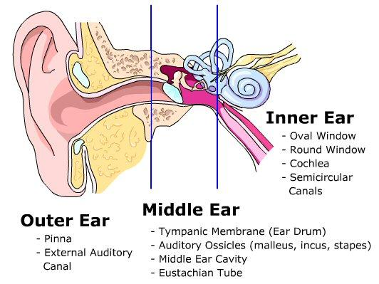
3 Parts
Sense of Hearing
Made up of:
Outer ear
Middle ear
Inner ear
Ear also functions as sense of equilibrium

Slide 3
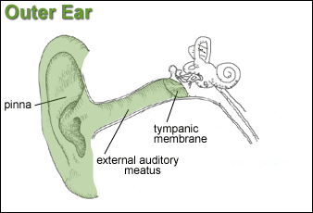
Outer (External) Ear
3 parts
Auricle (Pinna)
Funnel-like structure
External Acoustic Meatus (External Auditory Canal)
S-shaped tube
Eardrum (tympanic membrane)
Cone shaped
Sometimes considered part of middle ear

Slide 4
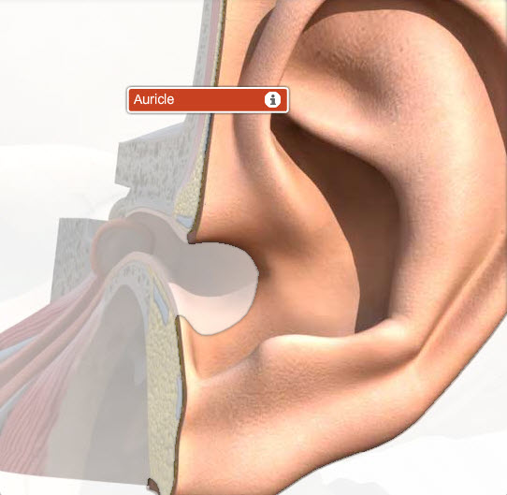
Auricle
Helps collect sound waves traveling through the air and directs them into the external acoustic meatus.

Slide 5
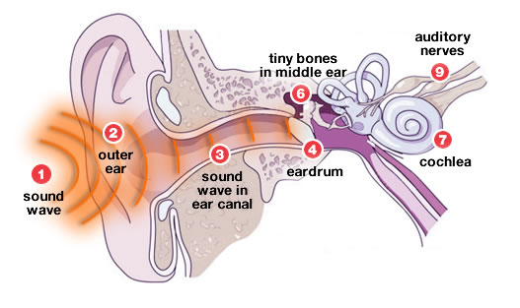
External Acoustic Meatus
As sound waves enter they change the pressure on the eardrum.

Slide 6
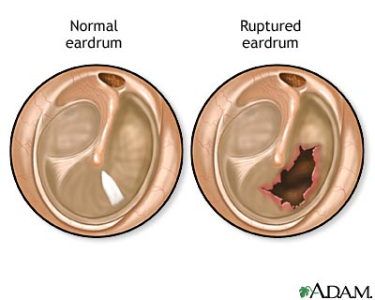
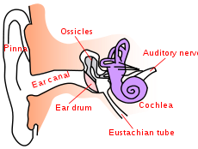
Eardrum
Semitransparent membrane covered by a thin layer of skin on its outer surface and a mucosa membrane in the inside
Has an oval margin and cone-shape with the cone apex pointing inward.

Slide 7
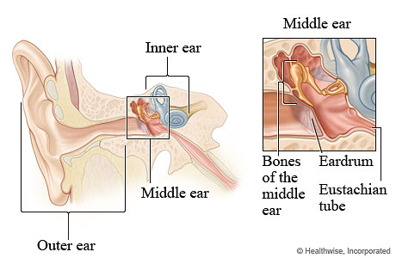
Middle Ear (Tympanic Cavity
Air-filled space in the temporal bone
Contains three bones called Auditory Ossicles
Malleus
Incus
Stapes
Oval Window
Opening of tympanic cavity that leads to inner ear
Auditory Tube (Eustachian Tube)
Connects middle ear to nasal cavity

Slide 8
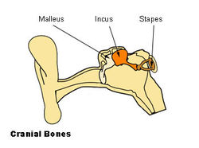
Auditory Ossicles
Tiny ligaments attach bones to wall of tympanic cavity
Are covered by mucous membrane
Bridge the ear drum and the inner ear
Transmit vibrations between eardrum and I.E.
Malleus is attached to ear drum
Once eardrum vibrates so does malleus which causes Incus and then Stapes to vibrate in unison.
Stapes is attached to oval window
Help increase(amplify) the force of vibrations from eardrum to oval window
Oval window vibrations move fluid in inner ear to stimulate hearing receptors

Slide 9
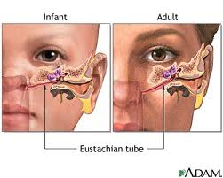
Auditory Tube Eustachian Tube
Connects middle ear to back of nasopharynx
Conducts air between tympanic cavity and the outside of body by way of nose and mouth
Helps maintain equal pressure of both sides of eardrum
Function is noticeable during rapid altitude changes
Popping sound is heard when hearing is restored back to normal

Slide 10
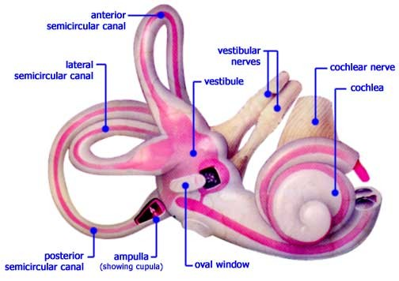
Inner (Internal) Ear
Consists of:
Labyrinth
Semicircular canals
Cochlea
Round window
Spiral Organ (Organ of Corti)

Slide 11
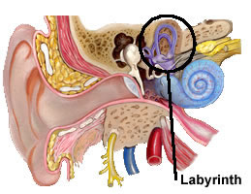
Labyrinth
Complex system of communicating chambers
2 Parts:
Osseous Labyrinth
Bony canal in temporal bone
Membranous Labyrinth
Similar shape of osseous labyrinth
Found within osseous labyrintjh
Fluid between labyrinths is called perilymph which is secreted by cells in the walls of the bony canal
Fluid within Membranous is called endolymph

Slide 12
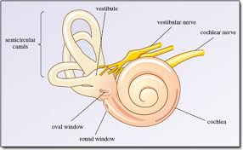
Semicircular Canals and Cochlea
SCC
Part of labyrinth
Provide sense of equilibrium
Chochlea
Functions in hearing
Has bony core and thin bony shelf that winds around the core like the threads of a screw
Shelf divides the osseous labyrinth of cochlea into upper and lower compartments
Upper Compartment (Scala Vestibuli)
Leads from oval window to apex of spiral
Lower Compartment (Scala Tympani)
Extends from Apex to round window

Slide 13
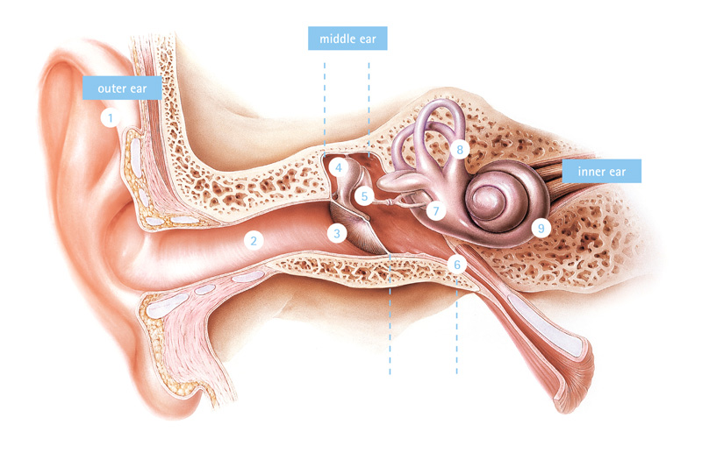
Cochlea Cont.
Round Window
Opening in the wall of inner ear
Cochlear Duct
Part of membranous labyrinth
Lies between to bony compartments and ends as a closed sac at the apex
Separated from scala vestibuli by vestibular membrane (Reissner’s membrane)
Separated from Scala Tympani by basilar membrane

Slide 14
Spiral Organ
AKA Organ of Corti
Contains hearing receptors
Receptor Cells
AKA Hair cells
Function somewhat like neurons
Move back and forth depending on pitch of sound
Young person
Detect sound waves ranging from 20-20,000 or more vibrations per second
2,000-3,000 is the range of greatest sensitivity
See Table 10.1 on page 274 for steps to hearing

Slide 15
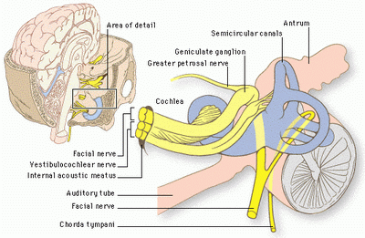
Nerve Pathways
Temporal Lobes interpret hearing
Follow the Vestibulocochlear cranial nerve

Slide 16
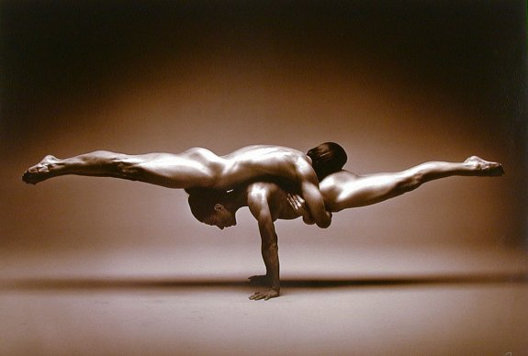
Sense of Equilibrium
2 Senses-2 different sensory organs
Static
Sense position of head
Maintain stability and posture when head is still
Dynamic
Sudden movement or rotation of head
Aid in maintaining balance

Slide 17
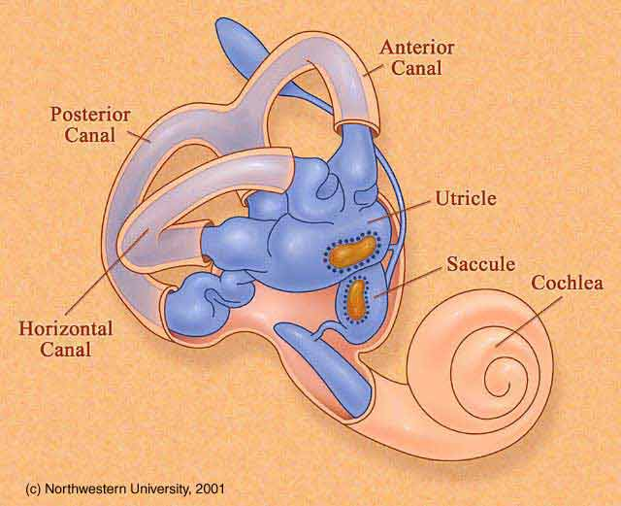
Static Equilibrium
Vestibule
Bony chamber between SCC and Cochlea
Contains:
Utricle
Saccule
Each of these have tiny hair like structures called macula
Head bending forward, backward, or to one side stimulate hair cells

Slide 18
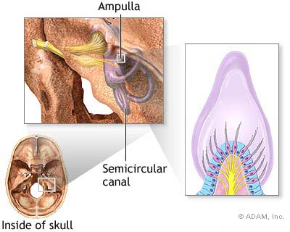
Dynamic Equilibrium
Organs are the three SCC
Contain:
Ampulla
Houses sensory organs called crista ampularis contain a number of sensory hair cells and supporting cells
Rapid turns of head stimulate crista ampularis
SCC move with head but fluid stays stationary
Cerebellum
Parts interpret impulses from SCC
Other organs help maintain balance
Eyes
Joints in neck

